Slide 1

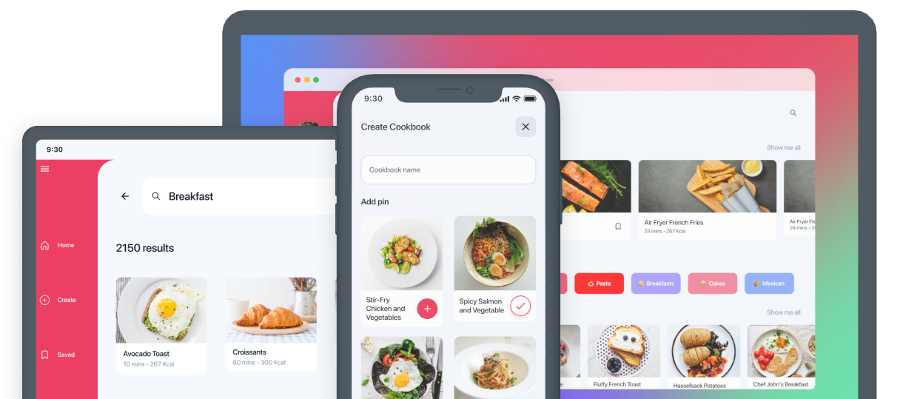
.NET Apps Everywhere!
Steve Bilogan
Notes:
Hello!
My name is Steve, I’m an engineer on the Uno Platform team and today I want to talk to you about how you can get your .NET apps up and running on any platform!
So, what I’ll do is give a quick overview on what Uno Platform is, how it works, and then we will jump into code and start building some apps

Slide 2








.NET
Notes:
So, what is Uno Platform?
Uno Platform, at its core, is a free and open-source framework for building cross platform applications
Basically, you can build apps using Uno Platform and target anywhere that .NET runs, all from a single codebase and a single project file
The core platform has single API layer for the UI that works across all platforms and plugs into the native rendering engines of each platform. Whether that UIKit on iOS, Android Views, HTML, or even Skia-based rendering for multiple different platforms
Now, that’s the core tech. On top of that there is an ecosystem for first-party libraries for things like themes/styles, additional complex controls, re-usable modules for things like navigation frameworks, presentation frameworks, dependency injection, etc.
There’s also great tooling for integration with other developer and designer tools like Figma and Visual Studio Code that we will jump into shortly
But next let’s take just get a peek at what an Uno app looks like

Slide 3
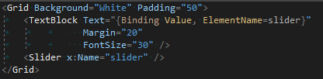
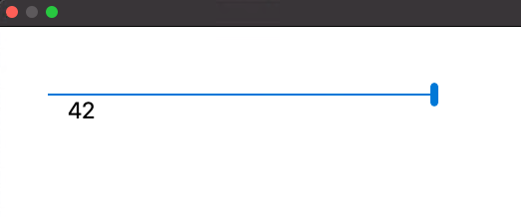

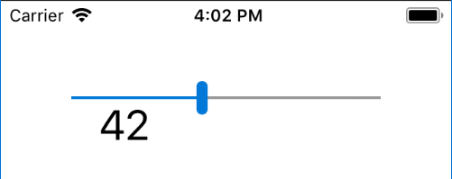
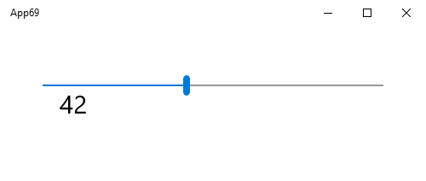

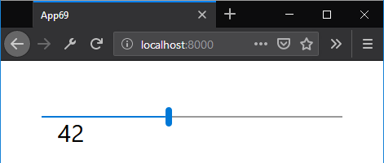
XAML
macOS
Linux
iOS
WINDOWS
ANDROID
WEBASSEMBLY
Notes:
Running out of room on this slide as we add more platforms
Here’s just a quick look at what I mean when I say you can write once and build everywhere. Just a simple piece of code here and you can see how it looks across all different platforms
If you’ll notice with the UI XAML code that we have here. It may look familiar to you if you are coming from the Windows world of development. This is straight WinUI XAML that is being built and running across all platforms

Slide 4
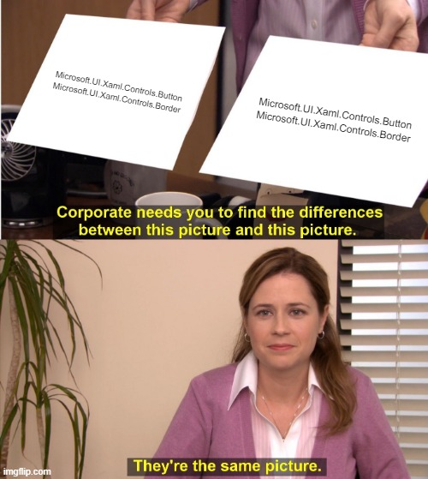

WinUI
Notes:
What we’re doing in the core of Uno Platform is taking the already established and well-documented APIs of building Windows apps using the WinUI APIs and making those APIs work on totally new platforms. Same code, same behaviors, same everything

Slide 5


Demo
We have a wizard!
https://new.platform.uno/
Notes:
Let’s start with our initial experience for getting an uno app built. Using the wizard!
Let’s go ahead and open Visual Studio and create a new Uno app from scratch
Open VS
New Uno App
Run through wizard options
SELECT MATERIAL
SELECT TOOLKIT
MVVM – Microsoft Community Toolkit
MVUX – part of the set of Uno Extensions family – more reactive, observable way of dealing with your presentation logic
Extensions – battle-test, modular pieces of functionality that you can pick and choose and bootstrap into your application
Create app
Show app structure
Change to Desktop target
Simple single project
All Assets in one place
Platforms folder for access to platform-specific stuff, app entrypoints
Go into CSPROJ: highlight UnoFeatures – go to link, talk about different features, nuget management
Here we only have Material, so our app will be styled with Material Design by default. Let’s take a look at what that looks like
Run Desktop
This is a WPF Shell top host that app and is using Skia as a rendering engine to draw the app
Right now we don’t really such much of the Material design styles, so we can add a button here
HOT RELOAD
Add new windows
Go to Figma
Show plugin
Copy Login page to app
HOT RELOAD
Connect multi window code
Full app generated initially from Figma and built is in our Samples repo
Go to Browser, show Commerce GitHub, mention Samples and Tutorials

Slide 6

Non-UI APIs
Accelerometer
App Actions
App Close Handler
App Suspension
Application Data and Settings
Badge Notifications
Barometer
Bluetooth
Clipboard
Contacts
Credential Storage
Device Enumeration
Device Information
E-mail
File Management
File and Folder Pickers
Flashlight
Geolocation (GPS)
Gyrometer
Haptics
Keeping Screen On
Light Sensor
Magnetometer
MIDI
Network Information
Orientation Sensor
Package Information
Personalization
Phone Calls
PowerManager
Proximity Sensor
Sharing
SMS
Settings
Speech Recognition
Step Counter
Title Bar Customization
URI Launcher
Vibration
Web Authentication Broker
Notes:
Now, we’ve focused a lot on the UI APIs that Uno Platform implements. But we also implement the non-UI APIs from Windows in a new cross-platform way. These runtime APIs cover a lot of ground from things like:
Accelerometer
Clipboard
Gamepad
Flashlight
Geolocation
All without needing any platform specific code

Slide 7


Non UI APIs https://aka.platform.uno/demo-unexpected-apis
Demo
Notes:
So, let’s look at some code and some examples of these non-UI APIs running
Network
Geolocator
Sharing
Speech
File
Mention GamePad
TitleBar

Slide 8
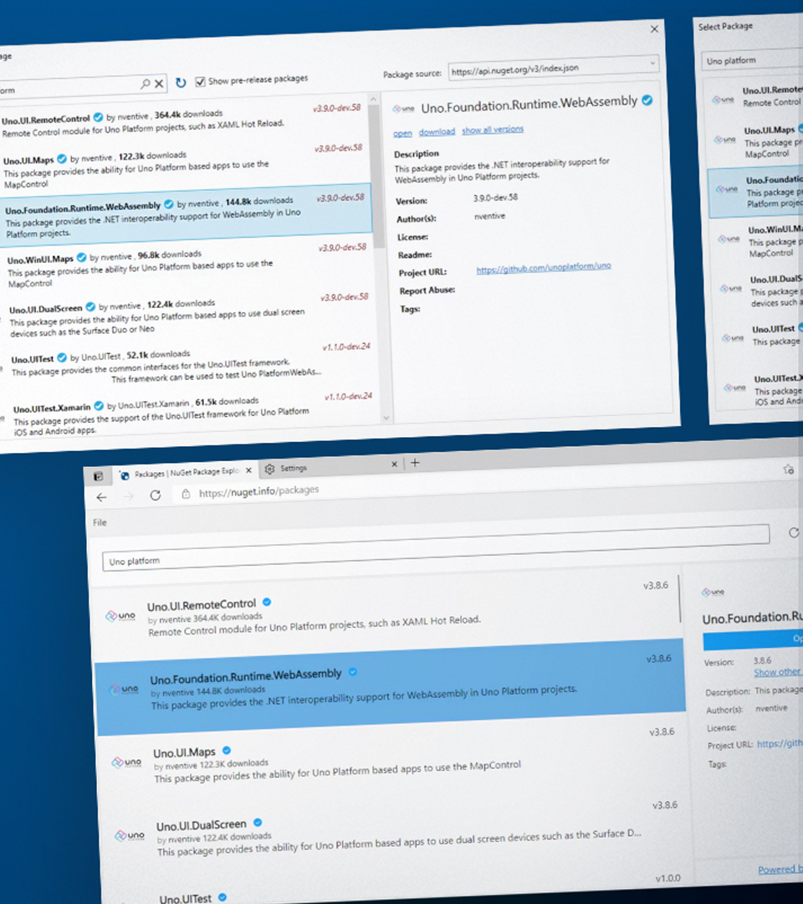

Case study
NuGet Package Explorer
Great Modernization Strategy
WinUI on the Web
30,000 Monthly Active Users
22% on non-Windows Machines
96% Web users post-deployment
NuGet.info
Notes:
NPE: WinUI on the Web
30,000 Monthly Active Users
22% on non-Windows Machines
96% Web users post-deployment
https://NuGet.info

Slide 9
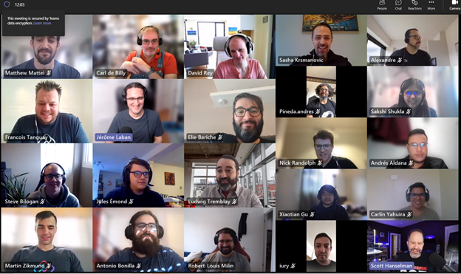




THANKS!
1
2
3
Try Uno Platform: platform.uno
Chat with us on Discord platform.uno/discord
Report issues or contribute github.com/unoplatform
https://kazo0.dev
@BiloganSteve
@kazo0

